Slide 1


Department of Information Technology V R Siddhartha Engineering College
GeoVision AI
LLM-Powered Satellite Image Analysis & Change Detection System
B.Tech in Information Technology MAJOR Project Review Presentation
Presented by
K Greeshma (228W1A12F9) G Teja (228W1A12E9)
Under the guidance of
Dr. V Radhe Syam, Sr.Asst Professor

Slide 2
Agenda
Introduction
Problem Statement
Objectives & Outcomes of the project
Literature Survey
Datasets and Requirements specifications
Algorithms involved
Architecture diagram
Complete Results Obtained
Result Analysis & Observations
Conclusion & Future Work
References

Slide 3
Introduction
Satellite imagery plays a crucial role in environmental monitoring, urban planning, and disaster management.
Rapid changes such as urbanization, deforestation, and climate impact require continuous analysis of land use.
Traditional methods of satellite image analysis are manual, time-consuming, and not scalable. With advancements in Artificial Intelligence and Deep Learning, automated analysis has become more efficient and accurate.
This project proposes an AI-driven system that performs:
Land cover classification
Image segmentation
Change detection
Real-time analysis with explainable outputs

Slide 4
Problem Statement
Rapid urbanization, deforestation, and environmental changes are continuously altering land use and land cover (LULC).
Traditional satellite image analysis methods are manual, time-consuming, and not scalable for large geographic regions.
Existing systems focus on isolated tasks such as classification or change detection, lacking an integrated approach.
Most solutions lack real-time data processing, user-friendly interfaces, and explainable outputs.
➡Therefore, there is a need for an intelligent, automated, and scalable system that integrates segmentation, classification, and change detection with real-time analysis and interpretability.

Slide 5
Objectives
To perform accurate land cover classification
using deep learning models.
To implement image segmentation for precise
region identification.
To detect temporal changes using advanced
models like U-Net.
To enable real-time satellite data acquisition
using NASA GIBS.
To incorporate LLM-based interpretation to provide quantitative analysis.
Outcomes
High-accuracy land cover classification (vegetation, urban, water,etc.)
Precise image segmentation with clear region boundaries
Reliable change detection maps highlighting environmental changes
Ability to process real-time satellite data
Development of a scalable and efficient geospatial analysis system

Slide 6
Literature Review
Title | Source | Description | Algorithm / Model | Results | Limitations
LLMs for Geospatial Reasoning,2025 | ACM SIGSPATIAL | Uses LLMs to analyze geospatial data and answer queries related to land use and environmental changes | GPT-based LLMs with prompt-based reasoning | Generates human-like explanations and supports decision-making | No direct spatial understanding, depends on input data quality
U-Net for Change Detection,2024 | IEEE Access | Detects pixel-level changes between multi-temporal satellite images for environmental monitoring | U-Net (Encoder–Decoder CNN with skip connections) | High accuracy (~90–95%), produces precise change maps | Requires large labeled datasets, high computational cost, no real-time support
SAM for Satellite Image Segmentation | IEEE TGRS | Uses SAM for prompt-based segmentation of high-resolution satellite images (vegetation, water, urban) | SAM (ViT-based) | Achieved IoU > 85%, works without fine-tuning | Poor performance on small objects, high memory usage, no classification
Land Cover Classification using Deep Learning | Remote Sensing (MDPI) | Deep learning pipeline for land cover classification using multi-temporal satellite data | CNN + U-Net + Random Forest | Accuracy ~88–91%, effective for urban growth detection | Sensitive to cloud noise, requires preprocessing and labeled data
LLM Benchmark for Geospatial Tasks,2025 | Int. Journal of Digital Earth | Evaluates performance of LLMs on multiple geospatial reasoning tasks | GPT-4, GPT-4o, Claude, GLM-4 | Best accuracy ~71%, shows potential of LLMs in geospatial domain | Limited spatial reasoning ability, heavy reliance on prompts

Slide 7
Literature Summary
Existing research shows that deep learning models like U-Net provide accurate pixel-level change detection in satellite imagery.
EfficientNet and CNN-based models achieve high performance in land cover classification tasks.
Segment Anything Model (SAM) enables effective segmentation of satellite images without task-specific training.
Large Language Models (LLMs) enhance interpretability by generating human-readable insights from geospatial data.
However, most existing systems:
Focus on individual tasks (segmentation, classification, or change detection)
Lack integration of multiple techniques
Do not support real-time data processing
Provide limited explainability and user interaction
Therefore, there is a need for an integrated system that combines segmentation, classification, change detection, and explainable AI which is addressed in our project.

Slide 8
Datasets
EuroSAT Dataset
Benchmark dataset for land use & land cover classification
Contains 10 classes (residential, forest, river, industrial, etc.)
Image size: 64 × 64 pixels
Source: Sentinel-2 satellite imagery
Used for training and evaluating classification
models (EfficientNet)
NASA GIBS Dataset
Provides real-time and historical satellite imagery
Accessed using Web Map Service (WMS)
Supports multi-temporal analysis
Used for dynamic image retrieval based on coordinates and date
Requirement Specifications
Programming & Frameworks
Programming Language: Python
Deep Learning Framework: TensorFlow
Libraries & Tools
OpenCV – Image preprocessing and manipulation
NumPy – Numerical computations and array operations
Web Technologies
Backend Framework: Flask
Frontend: React, JavaScript
APIs & Data Sources
NASA GIBS (WMS) – Real-time satellite image retrieval
OpenAI (LLM API) – Natural language report generation and interpretation

Slide 9
Algorithms Used: U-Net – Change Detection
FUNCTION DetectChangeUNet(image1, image2)
# Step 1: Initialize
Resize image1 and image2 to same dimensions
Normalize pixel values
# Step 2: Combine Inputs
combined_input = Concatenate(image1, image2) # shape: (H, W, 6)
# Step 3: Encoder (Downsampling)
FOR each encoder layer DO
Apply Convolution + ReLU
Apply MaxPooling
Store feature maps (for skip connections)
END FOR
# Step 4: Bottleneck
Apply Convolution layers to extract deep features
# Step 5: Decoder (Upsampling)
FOR each decoder layer DO
Apply UpSampling
Concatenate with corresponding encoder feature map
Apply Convolution + ReLU
END FOR
# Step 6: Output Layer
change_prob_map = Apply Sigmoid Activation
# Step 7: Thresholding
FOR each pixel in change_prob_map DO
IF pixel_value > 0.5 THEN
mark pixel as 1 (changed)
ELSE
mark pixel as 0 (unchanged)
END IF
END FOR
# Step 8: Post-processing
Apply morphological operations to remove noise
# Step 9: Compute Change Percentage
change_percentage = (Number of changed pixels / Total pixels) × 100
RETURN change_map, change_percentage
END FUNCTION

Slide 10
Algorithms Used: Segment Anything Model (SAM) – Image Segmentation
FUNCTION SegmentImageSAM(image)
# Step 1: Initialize
Load input image
Resize image to required dimensions
Normalize pixel values
# Step 2: Encode Image
image_embeddings = ImageEncoder(image)
# Extract high-level features using Vision Transformer
# Step 3: Generate Prompts
prompts = GenerateGridPoints(image)
# OR use text/point/box prompts
# Step 4: Mask Prediction
masks = []
FOR EACH prompt IN prompts DO
mask = MaskDecoder(image_embeddings, prompt)
add mask to masks
END FOR
# Step 5: Post-processing
FOR EACH mask IN masks DO
Remove small noisy regions
Smooth boundaries
END FOR
# Step 6: Combine Masks
segmented_output = Assign unique labels/colors to each mask
RETURN segmented_output
END FUNCTION

Slide 11
Algorithms Used: EfficientNet- Classification
FUNCTION ClassifyImageEfficientNet(image)
# Step 1: Initialize
Load input image
Resize image to (64 × 64)
Normalize pixel values (0 to 1)
# Step 2: Feature Extraction (Backbone Network)
features = EfficientNet_ConvolutionLayers(image)
# Extract spatial features like edges, textures, patterns
# Step 3: Global Pooling
pooled_features = GlobalMaxPooling(features)
# Step 4: Fully Connected Layers
dense1 = DenseLayer(pooled_features, activation = ReLU)
dropout1 = ApplyDropout(dense1)
dense2 = DenseLayer(dropout1, activation = ReLU)
dropout2 = ApplyDropout(dense2)
# Step 5: Output Layer
output = DenseLayer(dropout2, activation = Softmax)
# Step 6: Prediction
class_index = ArgMax(output)
confidence = Max(output)
RETURN class_index, confidence, output_probabilities
END FUNCTION

Slide 12
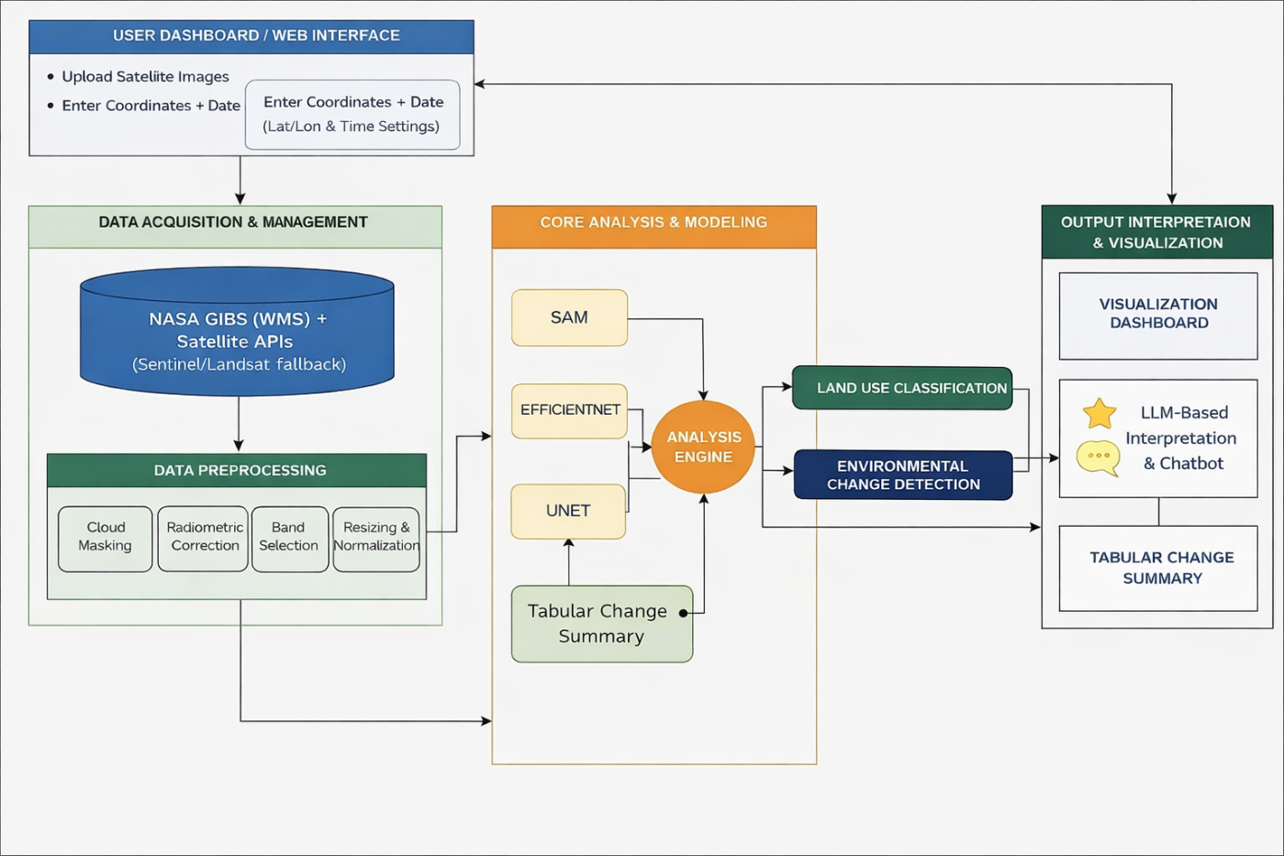
System Architecture
Fig: AI-driven geospatial analysis framework

Slide 13
Implementation steps
Data Collection
Collected EuroSAT dataset for training
Integrated NASA GIBS API for real-time satellite images
2. Data Preprocessing
Resized images (64×64 for classification, 256×256 for change detection)
Normalized pixel values
Removed noise and ensured consistency
3. Model Development
Implemented EfficientNet for land cover classification
Built U-Net architecture for change detection
Integrated SAM model for image segmentation
4. Model Training
Trained EfficientNet on EuroSAT dataset
Trained U-Net using synthetic/multi-temporal data
Evaluated performance using accuracy and metrics

Slide 14
Backend Development
Developed APIs using Flask
Implemented endpoints: /predict , /annotate , /change-detection
Frontend Development
Built UI using React & JavaScript
Enabled image upload and coordinate-based input
Displayed results with charts and visualizations
7. Integration
Connected frontend with backend APIs
Integrated NASA GIBS for real-time data
Added OpenAI LLM for explanation generation
Testing & Validation
Tested APIs using scripts
Validated outputs with sample images
Compared U-Net with traditional methods
Visualization & Output
Generated annotated images
Displayed change maps and statistics
Provided user-friendly dashboard

Slide 15
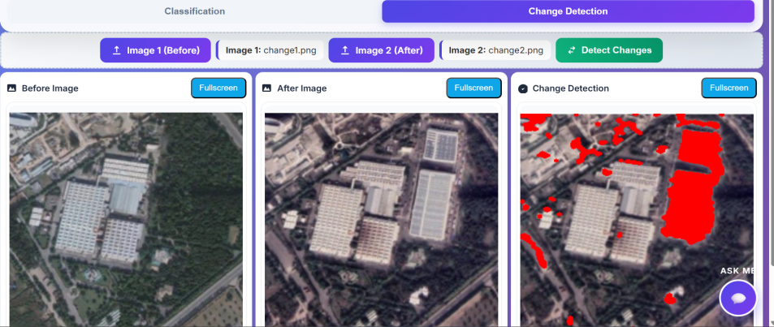
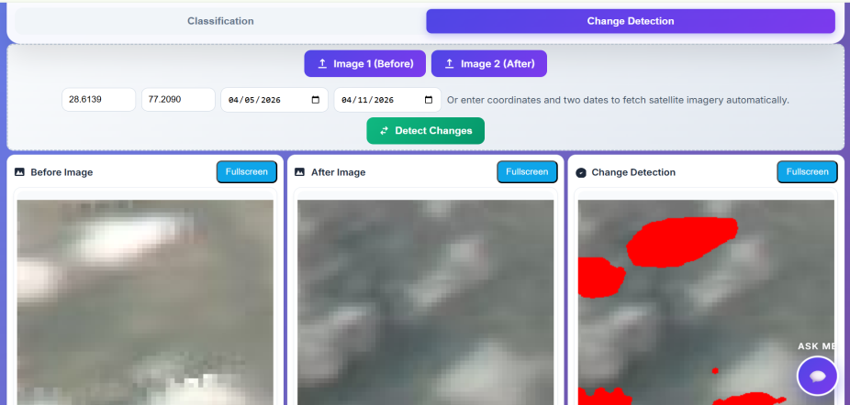
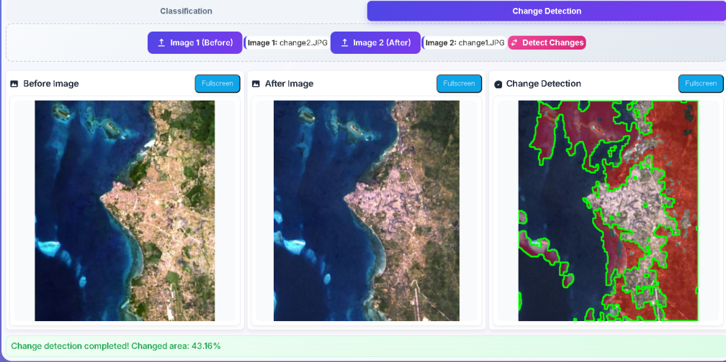
Results Obtained - Change Detection
Fig: Change detection using U-Net (manual upload)
Fig: Change detection using NASA GIBS (lat-long + date)
Fig: Change detection using K-Means

Slide 16
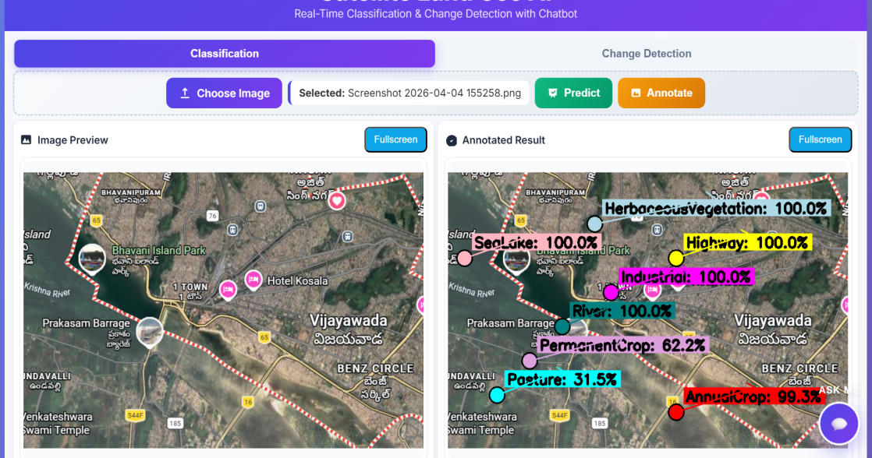
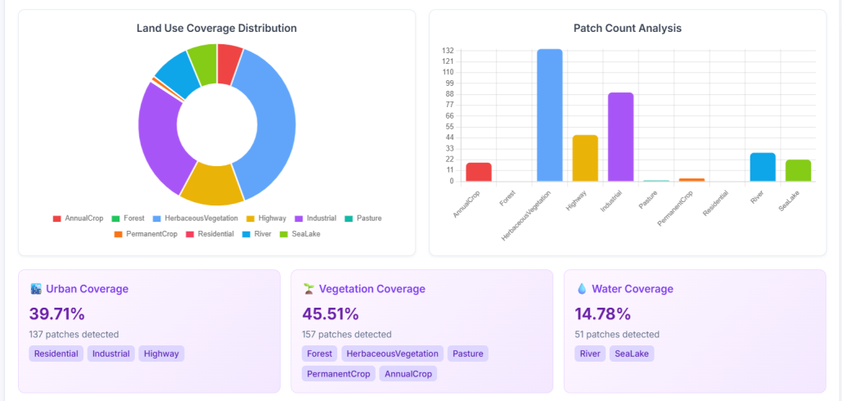
Results Obtained-Classification & Analysis
Fig: Classification using EfficientNet on SAM segmented image
Fig: Dashboard (land use analysis)

Slide 17
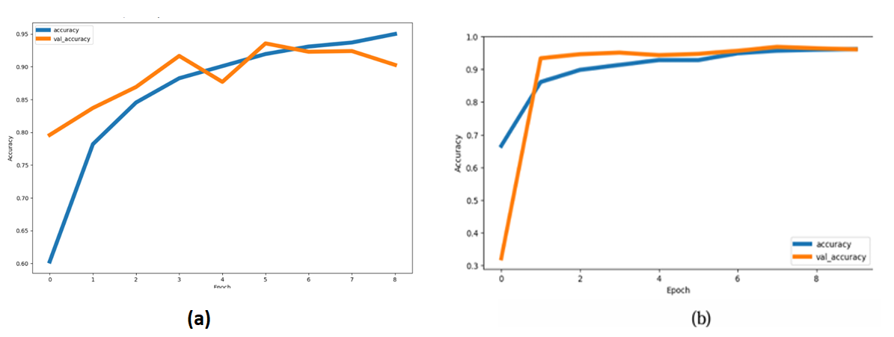
Result analysis - Model Performance
Fig: Accuracy curves (ResNet vs EfficientNet)

Slide 18
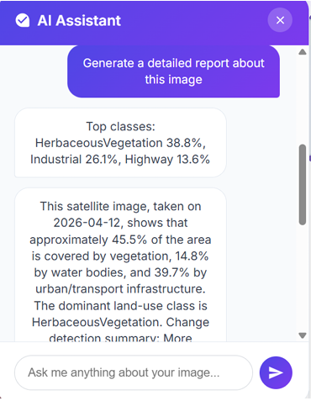
Result Analysis: Observations
U-Net provides accurate pixel-level change detection
K-Means produces noisy and less reliable outputs
SAM improves region-based classification
EfficientNet outperforms ResNet in accuracy and efficiency
Dashboard provides meaningful insights (coverage, diversity index)
LLM enhances interpretability and user interaction
Fig: Chatbot Analysis output on classified image

Slide 19
Conclusion
Developed an AI-driven satellite image analysis system integrating:
- Classification (EfficientNet)
- Segmentation (SAM)
- Change Detection (U-Net)
Achieved high accuracy in land cover classification and reliable change detection
Enabled real-time satellite data processing using NASA GIBS
Provided interpretable outputs using LLM-based explanations
Future Work
Improve accuracy using advanced models (Transformers, Vision Transformers)
Enhance real-time performance and optimization
Incorporate higher resolution and multi-spectral datasets
Deploy as a full-scale cloud/web application
Extend system for disaster prediction and environmental monitoring

Slide 20
References
[1] Ziming Li, Bin Chen, Shengbiao Wu, Mo Su, Jing M. Chen, Bing Xu, Deep learning for urban land use category classification: A review and experimental assessment, Remote Sensing of Environment, Volume 311, 2024, 114290, ISSN 0034-4257, https://doi.org/10.1016/j.rse.2024.114290
[2] Andreea F. Jocea, Liviu Porumb, Loredana Necula, Dragos Raducanu, Sentinel-2 Land Cover Classification: State-of-the-Art Methods and the Reality of Operational Deployment—A Systematic Review, Sustainability, Volume 17, 2025, 10324, https://doi.org/10.3390/su172210324
[3] Muhammad Zubair Ur Rehman, Sheikh Mohammed Shariful Islam, David Blake, Deep learning for land use classification: A systematic review of HS-LiDAR imagery, Artificial Intelligence Review, Volume 58, 2025, 272, https://doi.org/10.1007/s10462-025-11265-z
[4] Tsion Fekadu Deressu, Amanuel Kumsa Bojer, Taye Girma Debelee, Worku Gachena Negera, Saralees Nadarajah, Kena Wendimu Gebissa, Enhancing land use and land cover classification with deep learning-based satellite imagery segmentation, International Journal of Applied Earth Observation and Geoinformation, Volume 144, 2025, 104839, ISSN 1569-8432, https://doi.org/10.1016/j.jag.2025.104839
[5] Zhujun Gu, Maimai Zeng, The Use of Artificial Intelligence and Satellite Remote Sensing in Land Cover Change Detection: Review and Perspectives, Sustainability, Volume 16, 2023, 274, https://doi.org/10.3390/su16010274
[6] Fatih F. Şimşek, Determination of land use and land cover change using multi-temporal PlanetScope images and deep learning CNN model, Paddy and Water Environment, Volume 23, 2025, pp. 405–423, https://doi.org/10.1007/s10333-025-01024-9
[7] Jeyakumar Jagannathan, M.T. Vadivel, C. Divya, Land use classification using multi-year Sentinel-2 images with deep learning ensemble network, Scientific Reports, Volume 15, 2025, 29047, https://doi.org/10.1038/s41598-025-12512-7

Slide 21
[8] Ghulam Amin, Imtiaz Imtiaz, Ehtisham Haroon, Assessment of Machine Learning Algorithms for Land Cover Classification in a Complex Mountainous Landscape, Journal of Geovisualization and Spatial Analysis, Volume 8, 2024, 34, https://doi.org/10.1007/s41651-024-00195-z
[9] Muhammad Khan, Aamir Hanan, Madiyar Kenzhebay, Transformer-based land use and land cover classification with explainability using satellite imagery, Scientific Reports, Volume 14, 2024, 16744, https://doi.org/10.1038/s41598-024-67186-4
[10] Alireza A. Gharahbagh, Vahid Hajihashemi, Joao J.M. Machado, Joao M.R.S. Tavares, Land Cover Classification Model Using Multispectral Satellite Images Based on a Deep Learning Synergistic Semantic Segmentation Network, Sensors, Volume 25, 2025, 1988, https://doi.org/10.3390/s25071988
[11] Wei Zhang, Xiaofei Yang, Zhen Yuan, Zhen Chen, Yufei Xu, A Framework for Fine-Grained Land-Cover Classification Using 10 m Sentinel-2 Images, Remote Sensing, Volume 16, 2024, 390, https://doi.org/10.3390/rs16020390
[12] Abdullah M. Mashraqi, Eissa A. Alshari, Hatem T. Halawani, Emad M. Senan, Yahya Asiri, Bander M. Alowadhi, Hybrid deep learning and optimization-based land use and land cover classification for advancing sustainable agriculture, Scientific Reports, Volume 15, 2025, 41808, https://doi.org/10.1038/s41598-025-25908-2
[13] Fan Fan, Yilei Shi, Xiao Zhu, Land Cover Classification From Sentinel-2 Images With Quantum-Classical Convolutional Neural Networks, IEEE Journal of Selected Topics in Applied Earth Observations and Remote Sensing, 2024, https://doi.org/10.1109/JSTARS.2024.3411670
[14] Ming Hao, Xiaoli Zhang, Yong Liu, Land-use classification based on high-resolution remote sensing imagery and deep learning models, PLOS ONE, Volume 19, 2024, e0300473, https://doi.org/10.1371/journal.pone.0300473
[15] Yifan Wang, Qiang Li, Hongbo Zhao, Deep learning-based land use classification using spectral indices for improved feature representation, Remote Sensing, Volume 17, 2025, 1398, https://doi.org/10.3390/rs17081398

Slide 22
THANK YOU

